Slide 1

Datashader: Visualizing Big Data
Dr. James A. Bednar, Senior Manager, Technical Consulting
January 27, 2021
Notes:
Title slide (no headshot)
Best used for presentations with long titles or more than 2 speakers

Slide 2
Q: What is big data?
1,000 points?
1,000,000 points?
1,000,000,000 points?
A: Your data is big if:
There are too many data points to examine each one individually
You can only understand your data indirectly through stats and viz

Slide 3
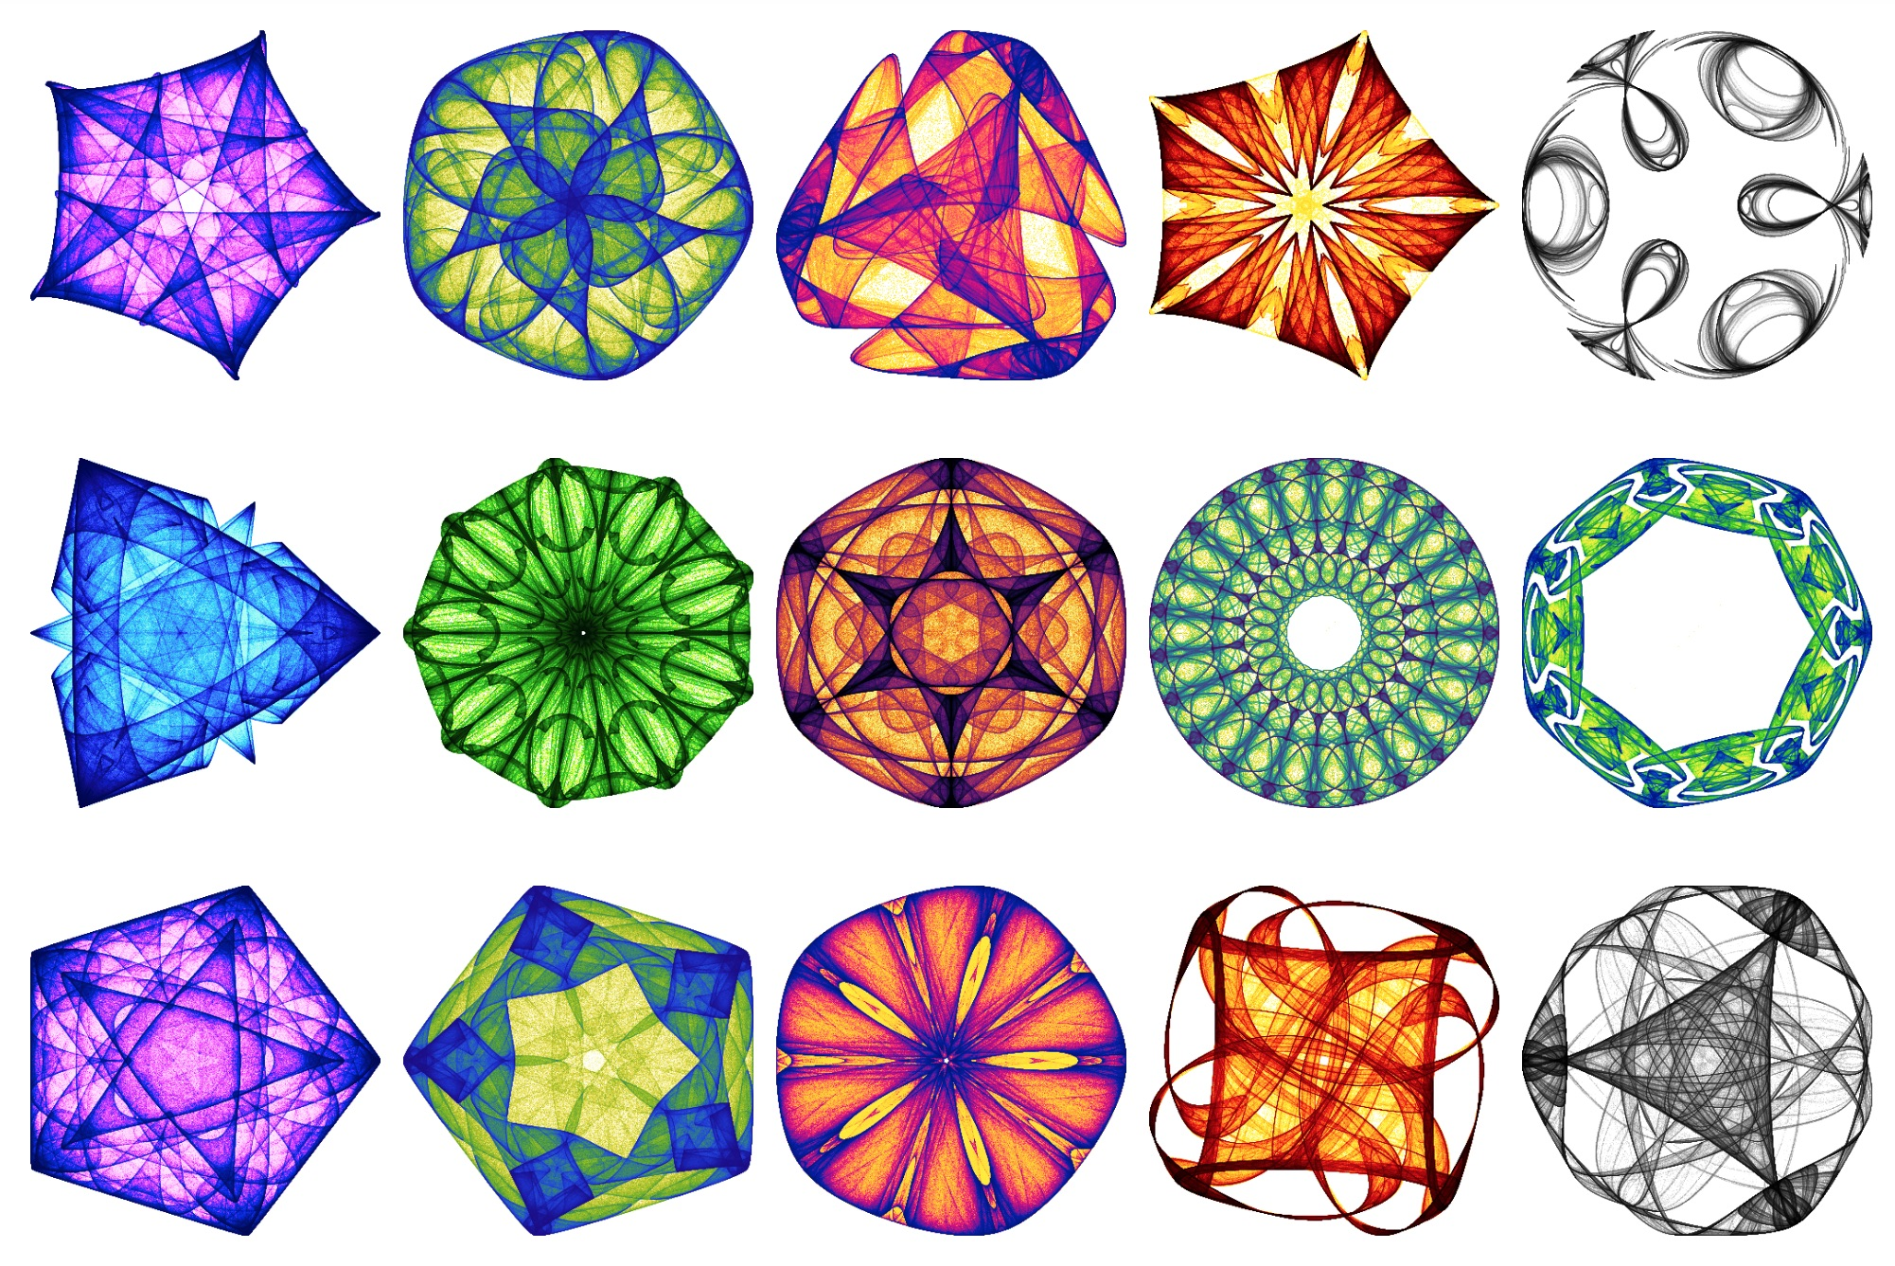
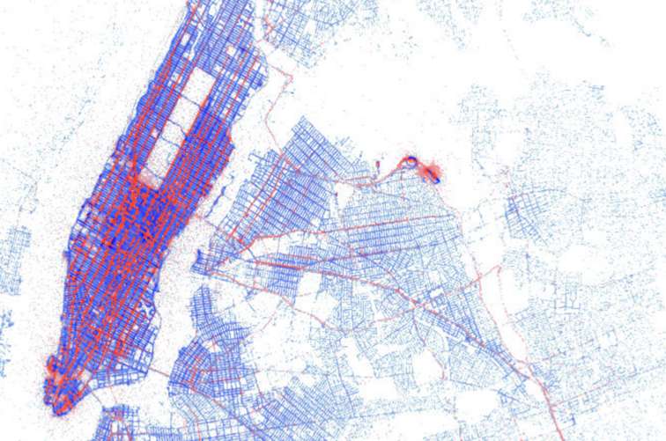
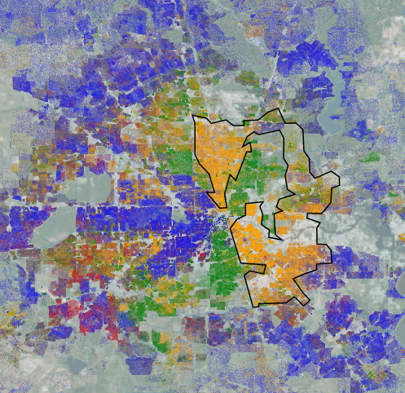
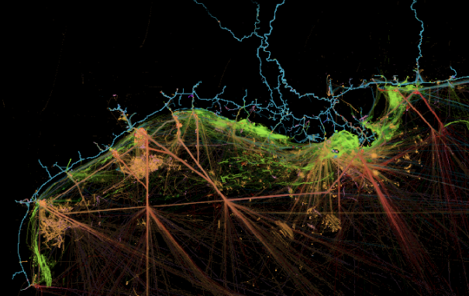
Q: What is Datashader?
A: Datashader is a Python library for rendering up to billions of datapoints on a laptop (or more on a cluster or NVIDIA GPU)
Datashader focuses on accurately revealing the entire distribution of your data, with minimal tuning or human intervention.

Slide 5
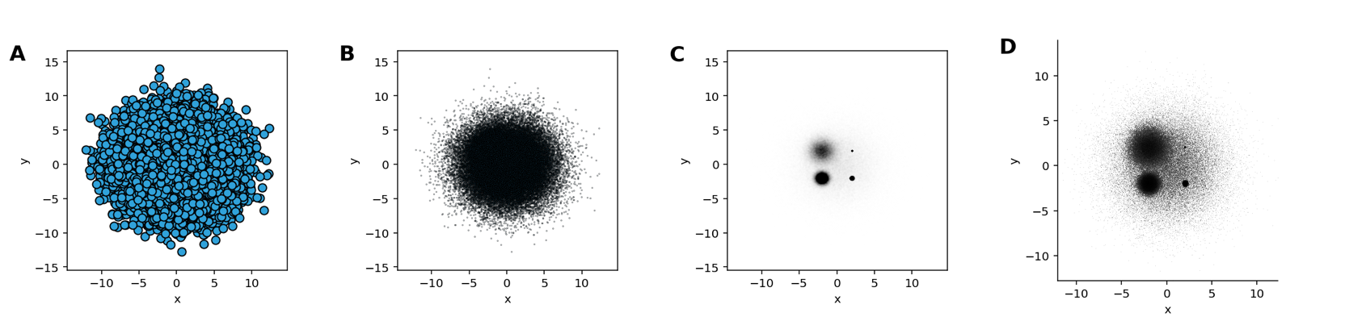
Other plotting programs hide your data’s structure
Four ways to plot the same 50,000 points— are any of them real?
A-C use a traditional plotting program adjusting point size and transparency.
D uses Datashader to render a heatmap, revealing shape with no parameter tuning.

Slide 6
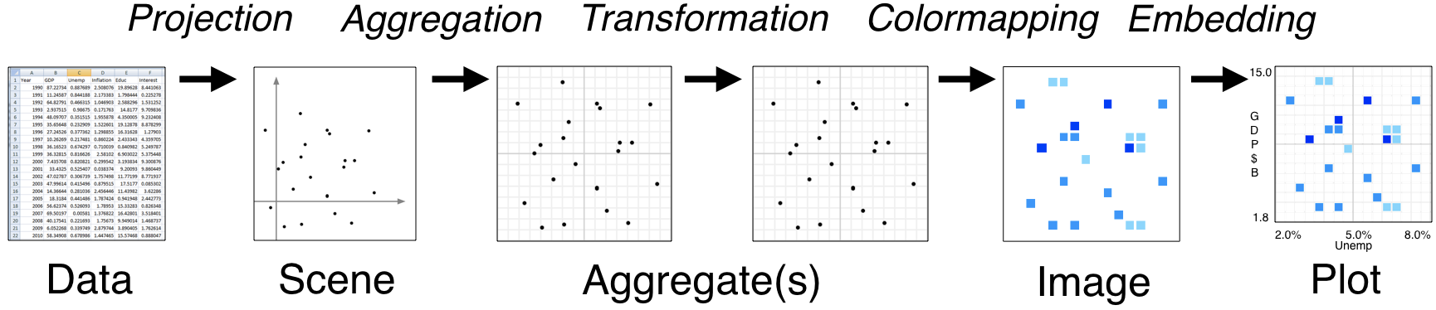
How Datashader works (1)
Instead of constructing a browser-based Plot directly from the Data, Datashader renders it into a screen-sized Aggregate array (often effectively a heatmap) or Image and sends that to the browser
Every step automatically adjusts to the data, but can be customized

Slide 7
How Datashader works (2)
The fixed-size array and using Numba/Dask/GPU optimized code makes arbitrarily large datasets practical even on laptops, desktops, and remotely
The aggregate array makes it possible to automate auto-ranging in every dimension, as well as supporting visual computations

Slide 8
Datashader in practice
Datashader can render millions or billions of points, lines/curves, areas, trajectories, raster/quadmesh/trimesh grids, polygons
Datashader supports multicore CPUs, Dask distributed clusters, and NVIDIA GPUs
Datashader itself only renders into arrays or images, but Bokeh, Matplotlib, Plotly, and HoloViews now offer extensive support for interactivity and other plotting features for Datashader

Slide 9
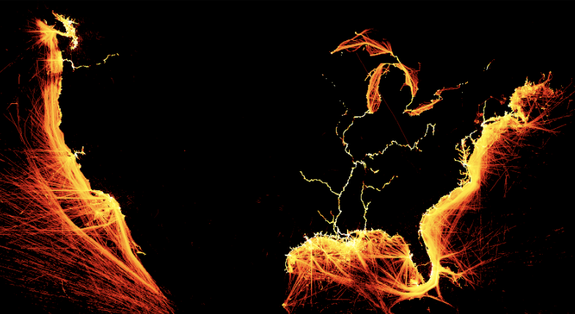
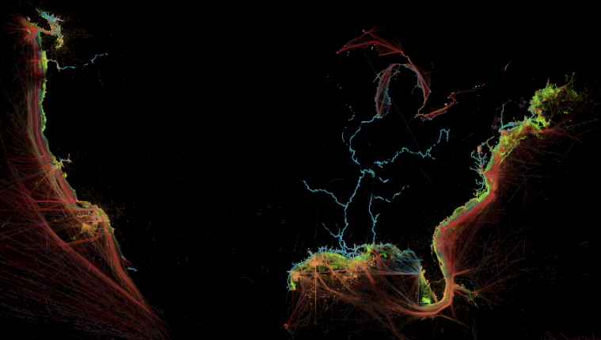
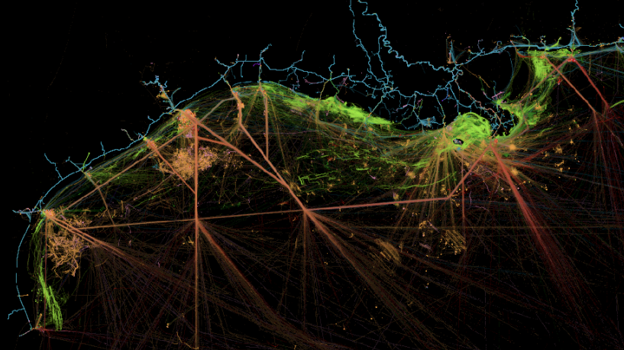
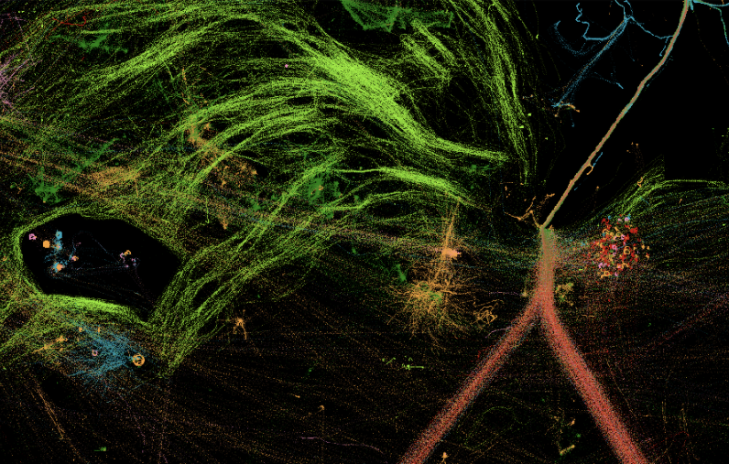
Example 1: Ship traffic
200 million GPS coords + vessel info
Renders in <1 sec on a laptop
Full dataset revealed with no tuning
Interactive app: explore each ship

Slide 10
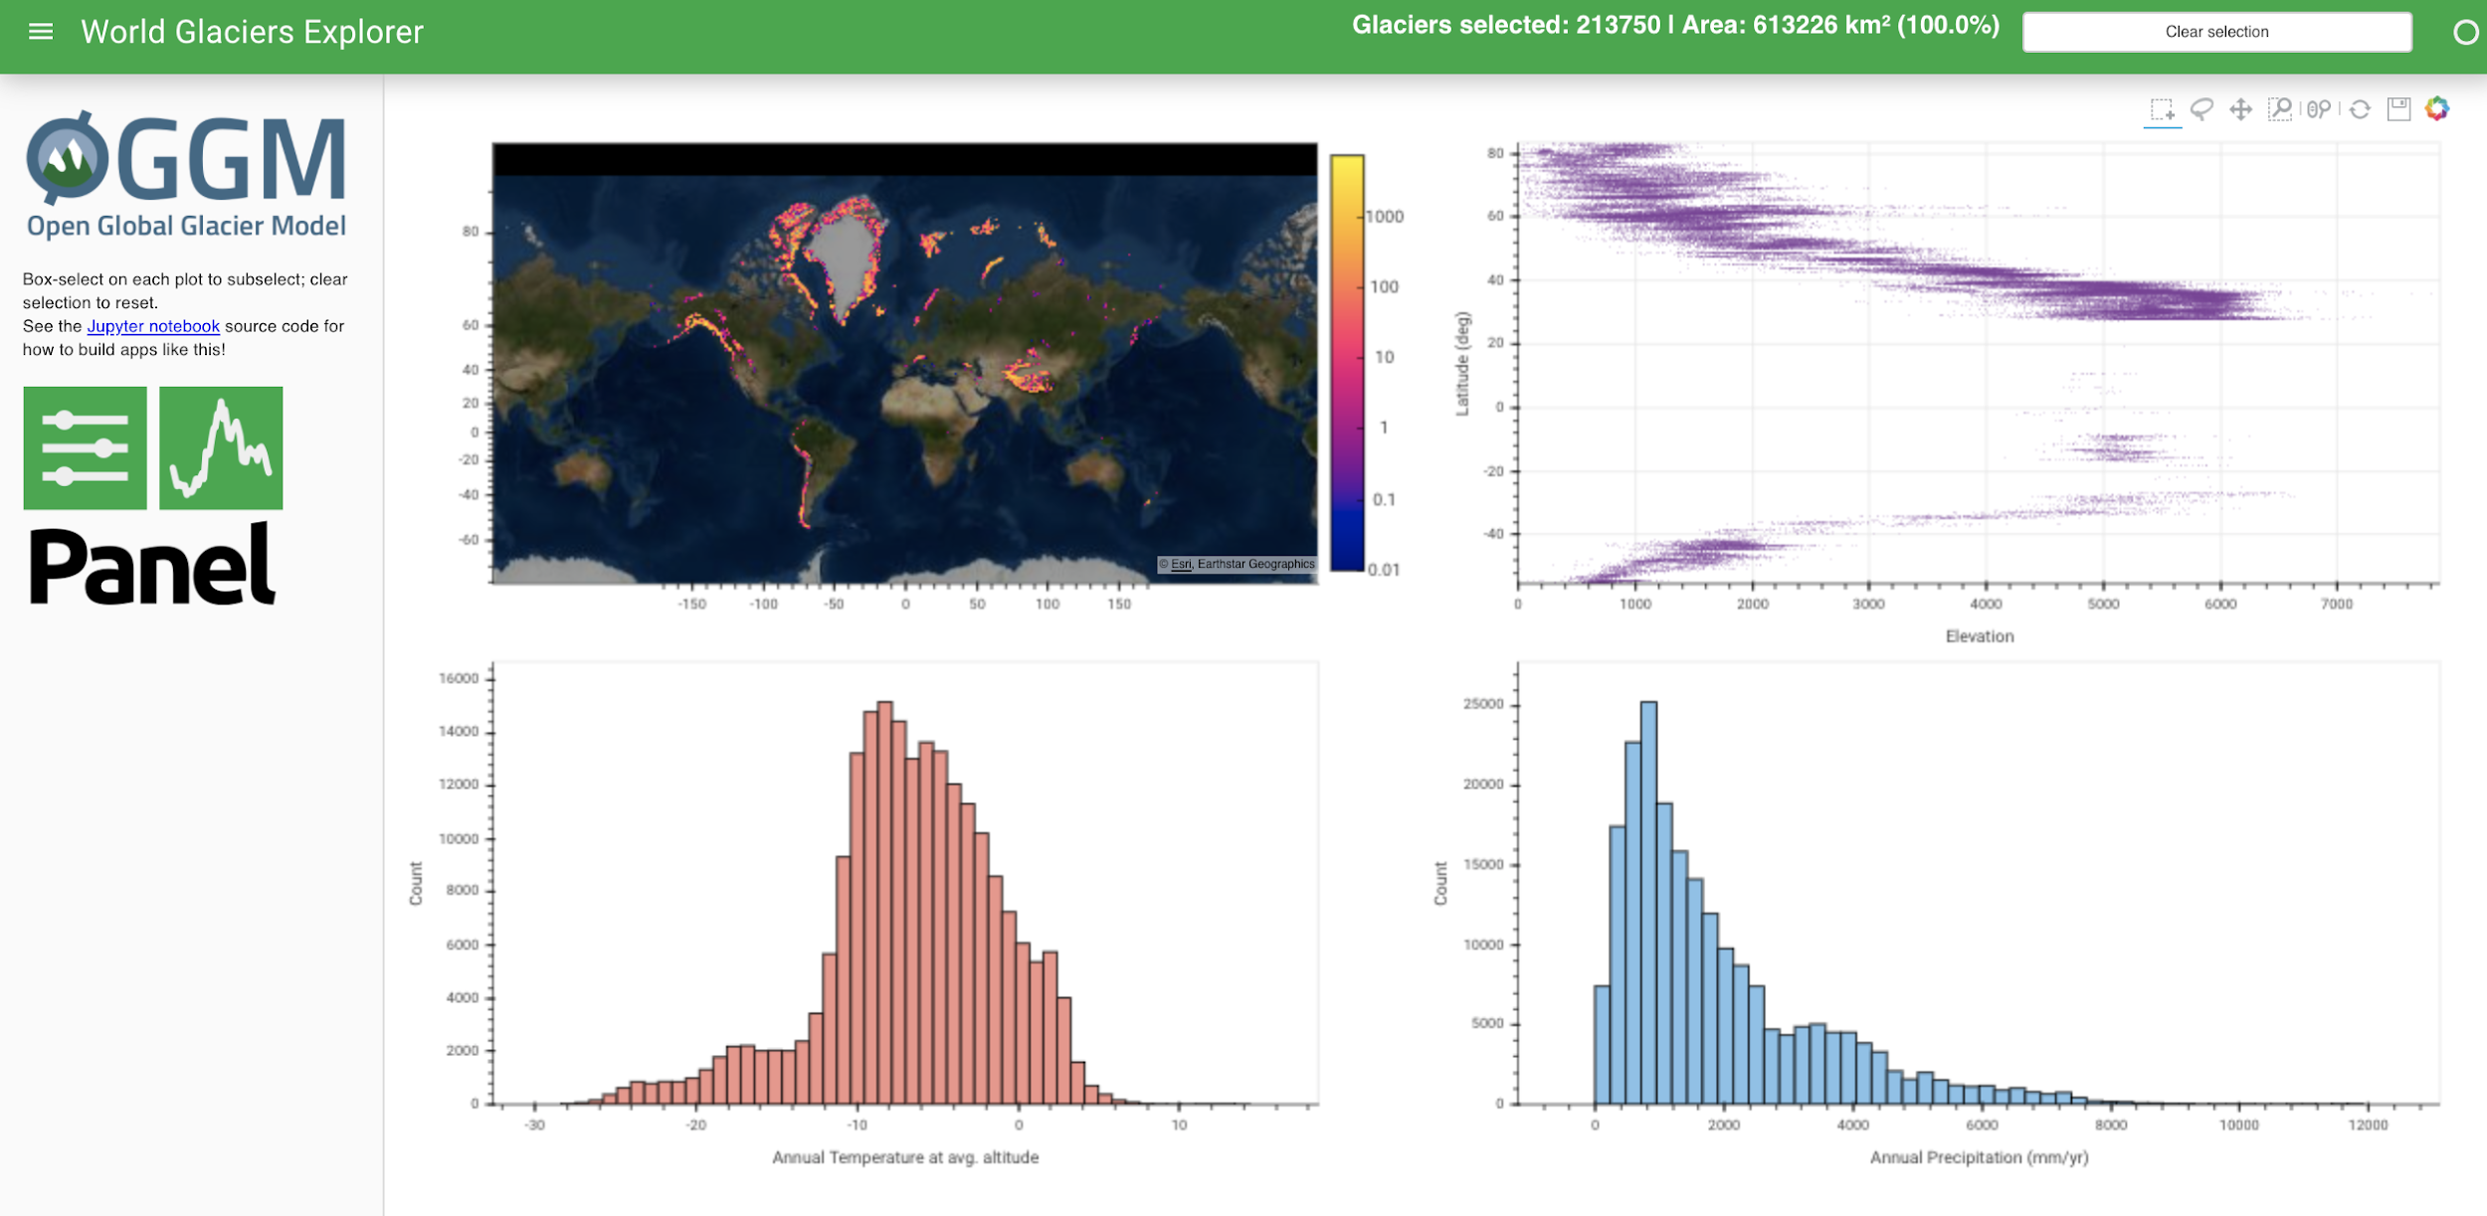
Example 2: Glaciers
200K glaciers
Easy cross filtering via link_ selections

Slide 11
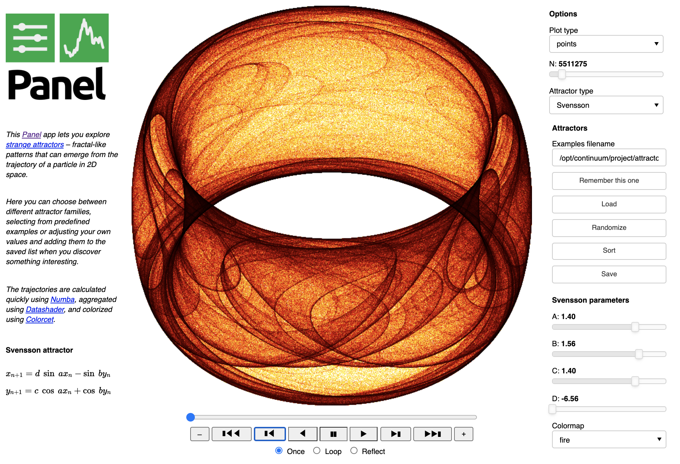
Example 3: Attractors
Raw Datashader rendering to PNG images
No axes or interactivity unless embedded into Bokeh, Plotly, Matplotlib, etc.

Slide 12
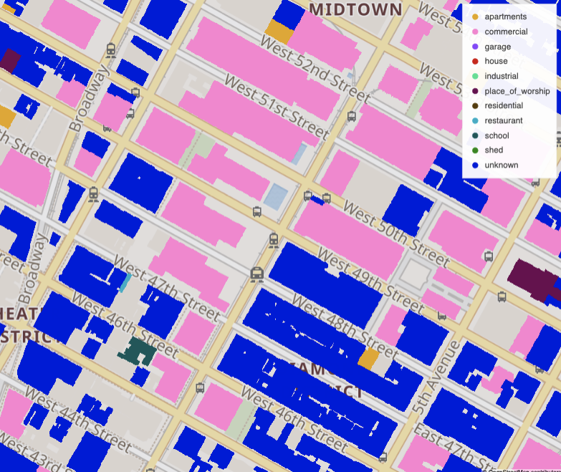
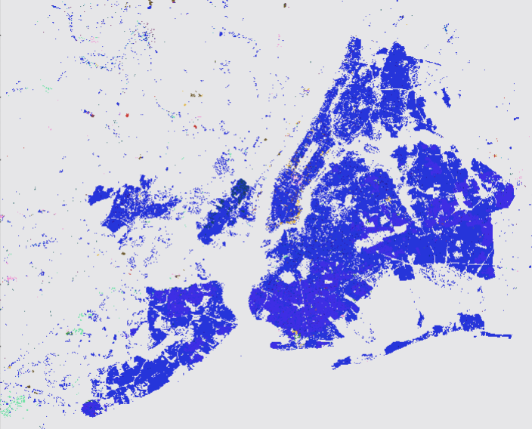
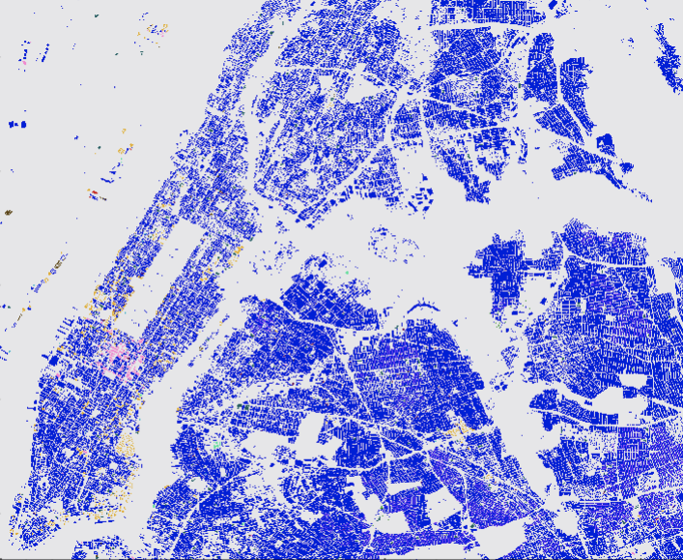
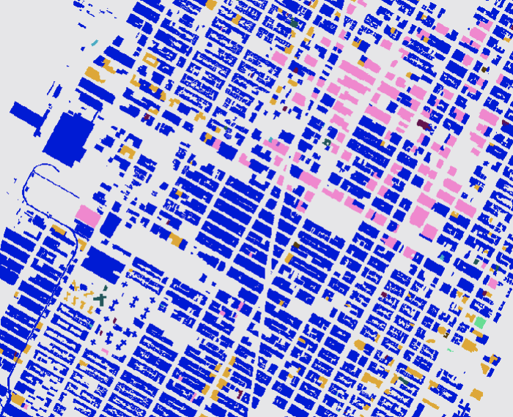
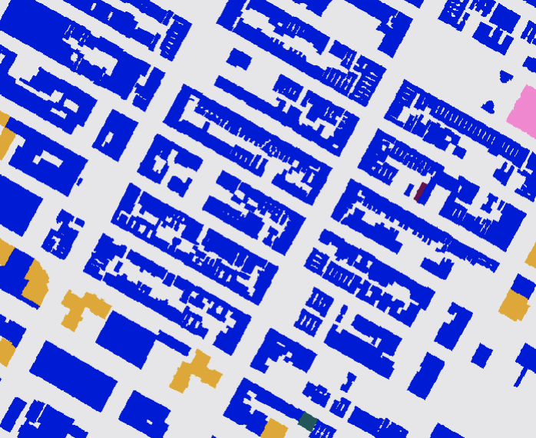
Example 4: NYC buildings
1.15 million detailed building outlines
Renders in <1/10 sec on a laptop

Slide 13
Exploring further
Today’s examples: bit.ly/datashader21
Many others: examples.pyviz.org , datashader.org
Full tutorial on Datashader/HoloViews/Panel: holoviz.org
For custom help or new features: sales@anaconda.com
Thanks to Datashader’s major contributors: Philipp Rudiger, Jon Mease, Jean-Luc Stevens, Jim Crist, Peter Wang
For points, also see: vaex, mpl_scatter_density

Slide 14


Thank You!

